Slide 1

Department of Computer Science and Engineering HFS-VAE: A Hierarchical Feature-Splitting Variational Autoencoder for Interpretable and Robust Network Intrusion Detection
PRESENTED BY
SHAIK MOHAMMAD THAHEER
SHAIK MANNEPALLI MASTANVALI
DERANGULA DURGA RAO
(22471A05D1)
(22471A05C9)
(22471A0585)
Under the Guidance of,
SURESH MUNNANGI _{MTech},
Assistant Professor
Department of Computer Science and Engineering,
Narasaraopeta Engineering College (Autonomous), Narasaraopet- 522 601.
Review No.3
Department of CSE

Slide 2
OUTLINE
Abstract
Introduction
Literature Survey
Research Gaps
Problem Statement
Objectives
Block Diagram / Flow Diagram
Methodology
Implementation
Results and Analysis
Conclusion & Future Scope
References
Acknowledgements
Question and Answers
Review No.3
Department of CSE

Slide 3
ABSTRACT
HFS-VAE is a hierarchical deep learning framework designed for interpretable and robust network intrusion detection.
It integrates Hierarchical Feature Splitting (HFS) with Variational Autoencoders (VAE) to learn modular latent representations from semantically grouped network features.
The model employs parallel encoder branches for flow, packet, and protocol-level features, followed by XGBoost-based classifier fusion for final detection.
Implemented using PyTorch, trained and evaluated on CICIDS2017 and NSL-KDD datasets after preprocessing and normalization.
It achieves high Average Precision (0.8412) and F1-score (0.7463) on CICIDS2017, demonstrating strong robustness, interpretability, and generalization for enterprise-scale cybersecurity applications.
Review No.3
Department of CSE

Slide 4
INTRODUCTION
Brief introduction to the project
The project titled “HFS-VAE – Hierarchical Feature-Splitting Variational Autoencoder” aims to build a deep learning model for detecting network intrusions.
It splits network data into groups like flow, packet, and protocol features, and processes them using parallel encoders.
These encoded features are then combined and classified using XGBoost to detect attacks accurately.
The model helps improve accuracy, robustness, and interpretability in identifying cyber threats in large-scale networks.
Review No 3.
Department of CSE

Slide 5
INTRODUCTION
Motivation behind the project
Cyberattacks are increasing rapidly, and manual or traditional detection methods struggle to handle new and unknown threats.
Existing intrusion detection systems often fail to detect zero-day attacks and lack robustness against complex network traffic.
Many deep learning models achieve high accuracy but remain black-box systems with low interpretability.
The HFS-VAE model aims to build a robust, accurate, and explainable intrusion detection system by learning structured features through hierarchical feature splitting.
Review No.3
Department of CSE

Slide 6
INTRODUCTION
Importance and relevance
Enhances cybersecurity by detecting both known and unknown network attacks effectively.
Improves interpretability through hierarchical feature splitting, helping users understand how attacks are identified.
Increases robustness and accuracy using deep learning and classifier fusion for reliable intrusion detection.
Supports real-world network security applications, making it suitable for enterprises and large-scale systems.
Review No.3
Department of CSE

Slide 7
LITERATURE SURVEY
SNo | Title | Author | Journal Name & Year | Methodology Adapted | Key Findings | Gaps
1 | NIDS-Vis: Improving the generalized adversarial robustness of network intrusion detection system | He, Kim, Asghar, 2024, Computers & Security | https://doi.org/10.1016/j.cose.2024.104028 | Data cleaning, normalization, and feature space partitioning using Autoencoder-based IDS. | Improved interpretability and robustness under adversarial conditions. Enhanced decision-boundary visualization for deep IDS models. | Evaluated only on IoT dataset (UQ-IoT); lacks modular latent structure.
2 | I. A Deep Learning Approach to Network Intrusion Detection | Shone et al., 2018, IEEE TETCI | https://ieeexplore.ieee.org/document/8264962 | Applied Stacked Autoencoder (SAE) combined with Random Forest classifier. | Showed effectiveness of unsupervised feature learning for intrusion detection. | Limited explainability and robustness; trained on older datasets.
3 | Deep Learning Approach for Intelligent Intrusion Detection System | Vinayakumar, Soman, Poornachandran, 2019, IEEE Access | https://ieeexplore.ieee.org/abstract/document/8681044 | Data cleaning, normalization, and feature selection. Used DNN, CNN, RNN, and Autoencoder | IDeep learning achieved higher accuracy than traditional ML across multiple datasets. Demonstrated scalability for large network traffic data. | High computational cost, limited interpretability, and weak adversarial robustness.
4 | Toward Generating a New Intrusion Detection Dataset and Intrusion Traffic Characterization | Sharafaldin, Lashkari, Ghorbani, 2018, ICISSP | https://www.scitepress.org/Papers/2018/66398/66398.pdf | Captured real network traffic using CICFlowMeter tool. | Introduced CICIDS2017, a realistic dataset covering DDoS, Botnet, Web, and Infiltration attacks. | Class imbalance in some attack categories; high preprocessing overhead.
5 | An Efficient Intrusion Detection System Using Hybrid Deep Learning Model in IoT Networks | . Vignesh, R. Ashokkumar, N. Niranjan, S. Sendil Kumar, S. Siva Shankar 2025 | https://link.springer.com/article/10.1186/s13638-025-02477-6 | Data cleaning, normalization, and feature extraction. Implemented Hybrid Deep Learning model | Improved detection accuracy for IoT network intrusions. Hybrid architectures outperform standalone deep learning models. | Data cleaning, normalization, and feature extraction. Implemented Hybrid Deep Learning model
Review No.3
Department of CSE

Slide 8
LITERATURE SURVEY
Anomaly-Based Intrusion Detection Framework
Denning et al.
Proposed one of the first models to detect abnormal system and network behaviors.
Used statistical analysis to compare current and normal profiles for anomaly detection.
Provided the base concept for all later machine-learning intrusion detection systems.
Autoencoder-Based Intrusion Detection System
Mirsky et al.
Introduced Kitsune, an ensemble of lightweight autoencoders for real-time detection.
Focused on unsupervised learning to identify unknown and zero-day attacks.
Proved autoencoders are effective for reconstructing normal traffic patterns.
Review No.3
Department of CSE

Slide 9
LITERATURE SURVEY
Variational Autoencoder for Network Intrusion Detection
Zhao et al.
Utilized Variational Autoencoders (VAEs) to model normal network traffic distribution.
Detected anomalies using reconstruction error and latent feature deviation.
Enhanced detection accuracy on complex and imbalanced network datasets.
NIDS-Vis: Visualization and Robustness in NIDS
He et al.
Proposed Feature Space Partitioning (FSP) and Distributional Loss Function (DLF).
Improved the interpretability and adversarial robustness of deep NIDS.
Visualized decision boundaries and latent spaces for model explanation.
Review No.3
Department of CSE

Slide 10
LITERATURE SURVEY
Hybrid VAE–XGBoost Intrusion Detection Model
Wang et al.
Combined latent features from VAEs with XGBoost for final classification.
Improved both detection accuracy and resistance to adversarial attacks.
Demonstrated that hybrid models outperform single deep networks in IDS.
Hierarchical Feature-Splitting Variational Autoencoder (HFS-VAE)
Thaheer et al. (Proposed Work)
Introduced Hierarchical Feature Splitting (HFS) to separate flow, packet, and protocol features.
Trained parallel VAE encoders for each group and fused outputs via XGBoost classifier.
Achieved high accuracy, interpretability, and robustness on CICIDS2017 and NSL-KDD datasets.
Review No.3
Department of CSE

Slide 11
RESEARCH GAPS
Existing intrusion detection models lack interpretability and robustness, making it difficult to understand how attacks are detected.
Most IDS models struggle to generalize to new or unseen attacks, especially with outdated or imbalanced datasets.
There is a need for a hybrid and modular deep learning approach that combines effective feature learning with strong detection accuracy and explainability.
Review No.3
Department of CSE

Slide 12
PROBLEM STATEMENT
Traditional intrusion detection systems are often unable to effectively detect new or unknown cyberattacks due to their reliance on static signatures and shallow learning methods.
Existing deep learning-based IDS models, while achieving high accuracy, still suffer from low interpretability, poor generalization, and vulnerability to adversarial attacks.
Furthermore, most models treat all network features uniformly, ignoring the hierarchical relationships between flow-level, packet-level, and protocol-level features.
Hence, there is a need for a robust and interpretable intrusion detection framework that can learn structured representations from diverse network features and reliably detect both known and unknown attacks in large-scale environments.
Review No.3
Department of CSE

Slide 13
OBJECTIVES
To develop a Hierarchical Feature-Splitting Variational Autoencoder (HFS-VAE) model for robust and interpretable network intrusion detection.
To separate network features into flow, packet, and protocol-level groups for effective and modular feature learning.
To train parallel VAE encoders and combine their latent representations using an XGBoost classifier for accurate attack detection.
To enhance the robustness and generalization of the intrusion detection system against unseen and adversarial attacks.
To evaluate the proposed model using benchmark datasets like CICIDS2017 and NSL-KDD, ensuring high accuracy and interpretability.
Review No.3
Department of CSE

Slide 14
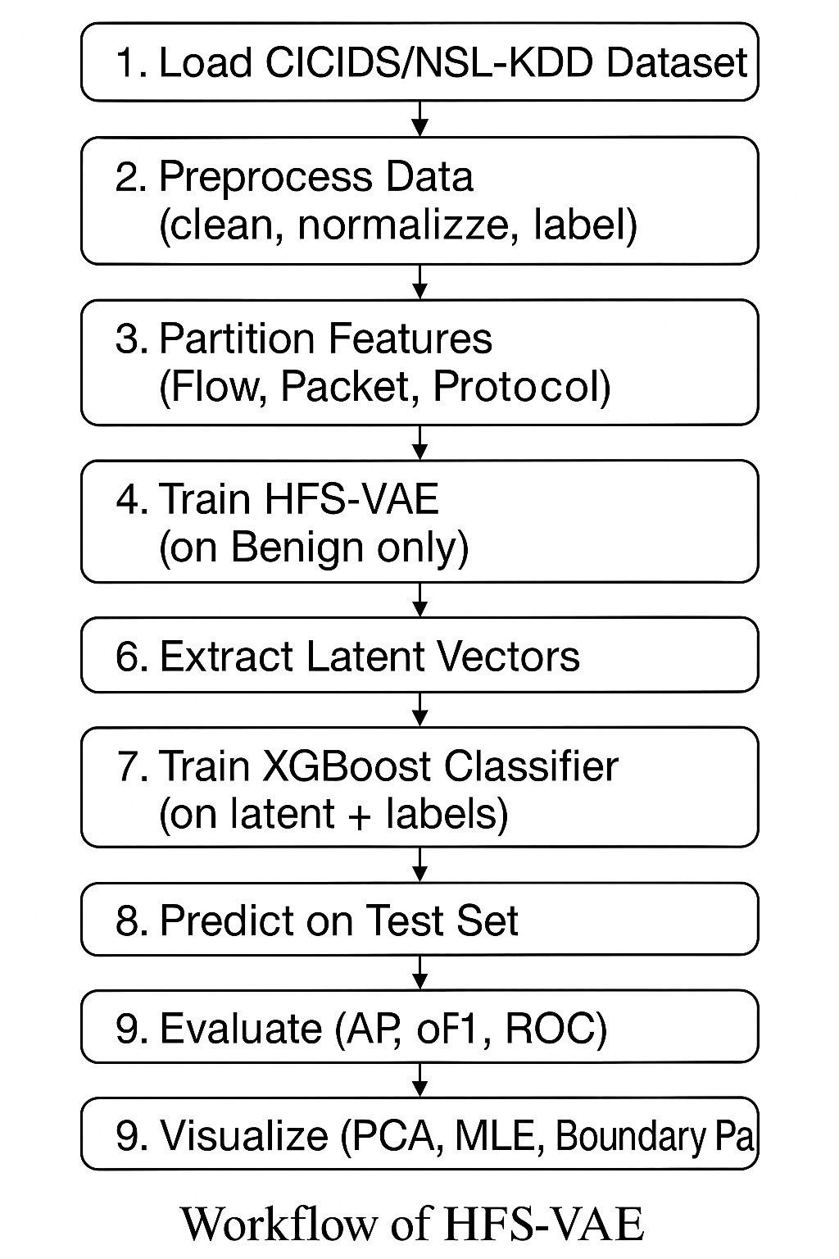
BLOCK DIAGRAM OR FLOW DIAGRAM
Review No.3
Department of CSE

Slide 15
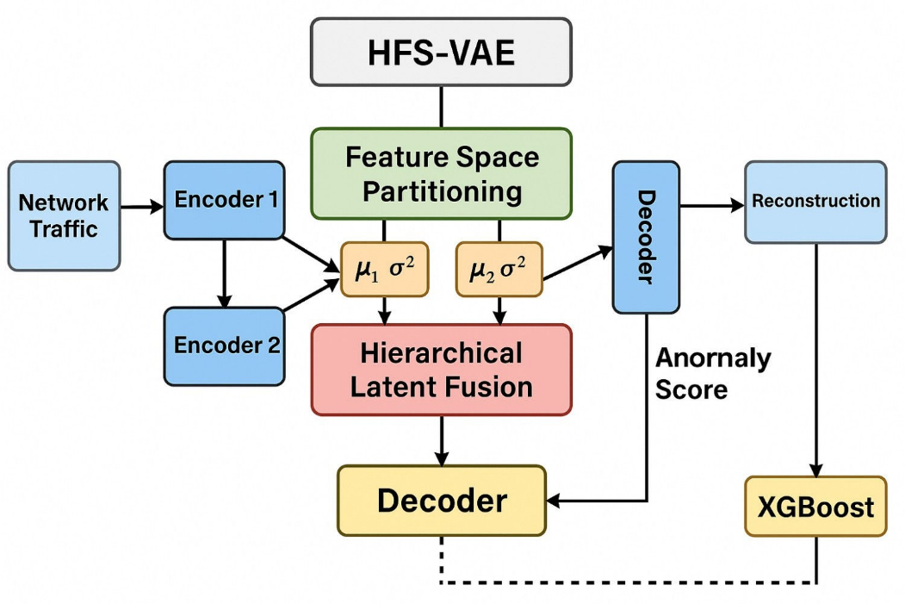
METHODOLOGY
1. Data Collection and Preprocessing
Datasets such as CICIDS2017 and NSL-KDD are used for training and testing.
Raw network traffic data is cleaned, normalized, and converted into numerical format.
Features are analyzed and categorized into three main groups: Flow-level, Packet-level, and Protocol-level features.
2. Hierarchical Feature Splitting (HFS)
Features are divided into three semantic groups based on their network characteristics.
This structured division helps in learning distinct latent representations for each feature type.
It improves model interpretability and modular learning.
Review No.3
Department of CSE

Slide 16
METHODOLOGY
3. Multi-Encoder VAE Architecture
Separate VAE encoders are trained for each feature group.
Each encoder learns latent representations capturing unique characteristics of flow, packet, and protocol data.
The Distributional Loss Function (DLF) ensures stable and well-structured latent spaces.
4. Latent Feature Fusion and Classification
The latent vectors from all three VAEs are concatenated into a single combined feature representation.
An XGBoost classifier is trained on the fused features for final intrusion detection.
This hybrid approach combines unsupervised representation learning with supervised classification.
5. Model Evaluation
The model is evaluated on CICIDS2017 and NSL-KDD datasets.
Metrics such as Accuracy, Precision, Recall, F1-score, and AUC are used.
Visualization tools and latent-space analysis are used to verify interpretability and robustness.
Review No.3
Department of CSE

Slide 17
IMPLEMENTATION
Software and Hardware Specifications :
Python 3.10, PyTorch, TorchVision
OpenCV, NumPy, Matplotlib
Google Colab (GPU-enabled)
NVIDIA T4 / V100 GPU, 16 GB VRAM, 12 GB RAM
Implementation Summary
Prepared CICIDS2017 and NSL-KDD datasets after cleaning and normalization.
Applied Hierarchical Feature Splitting into flow, packet, and protocol groups.
Built HFS-VAE with parallel encoders and fused outputs using XGBoost.
Trained for 50 epochs with Adam optimizer and evaluated using standard IDS metrics.
Review No.3
Department of CSE

Slide 18
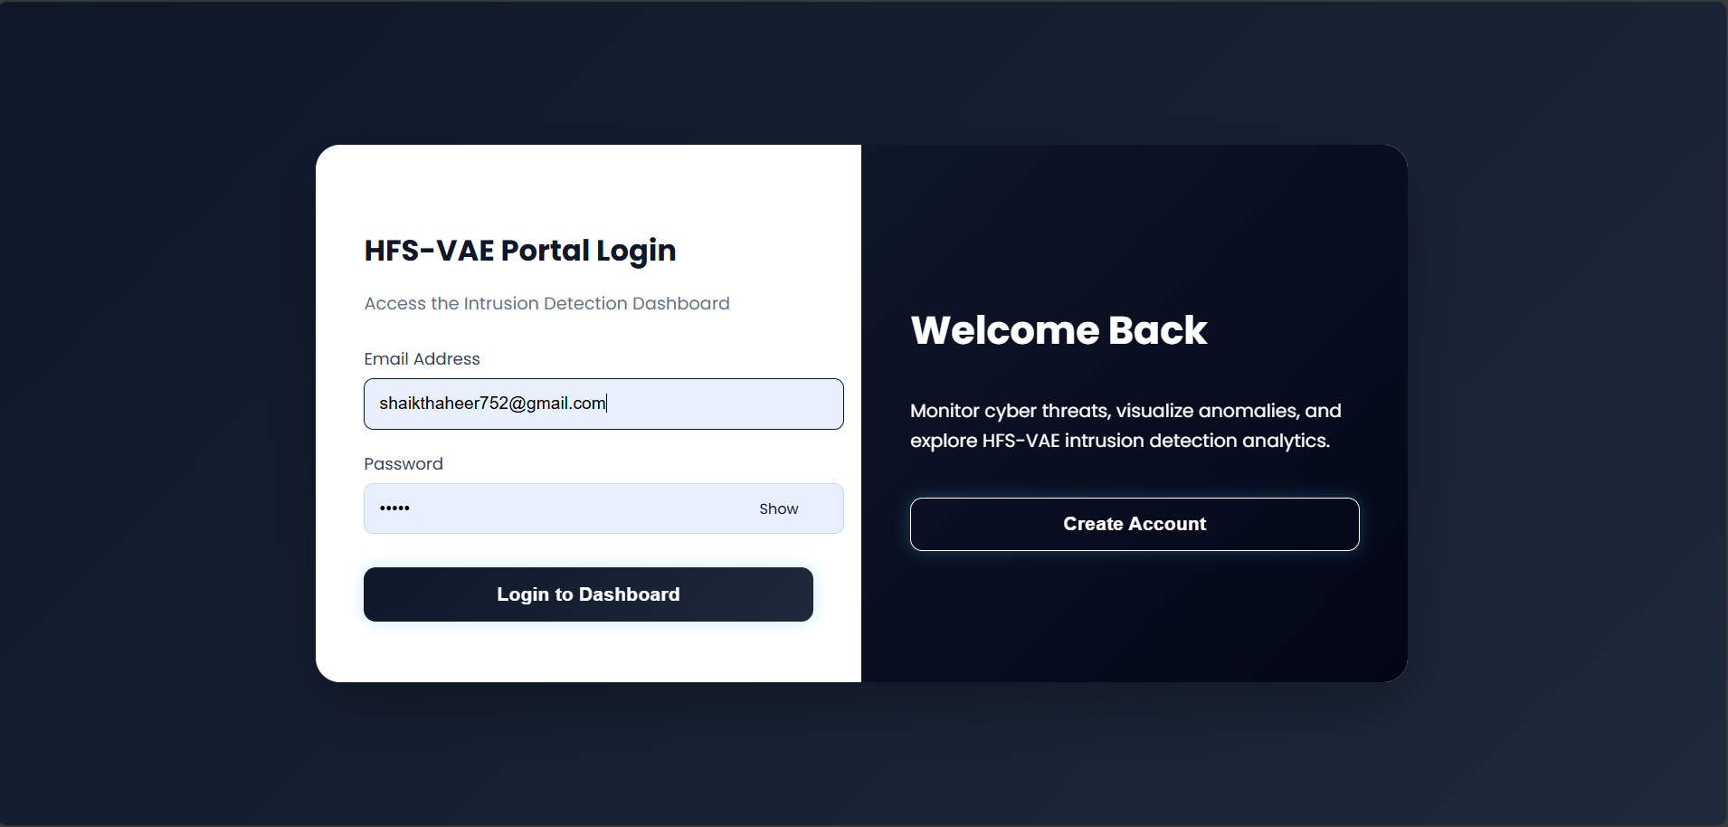
FRONTEND IMPLEMENTATION
Review No.3
Batch No: BB5
Department of CSE

Slide 19
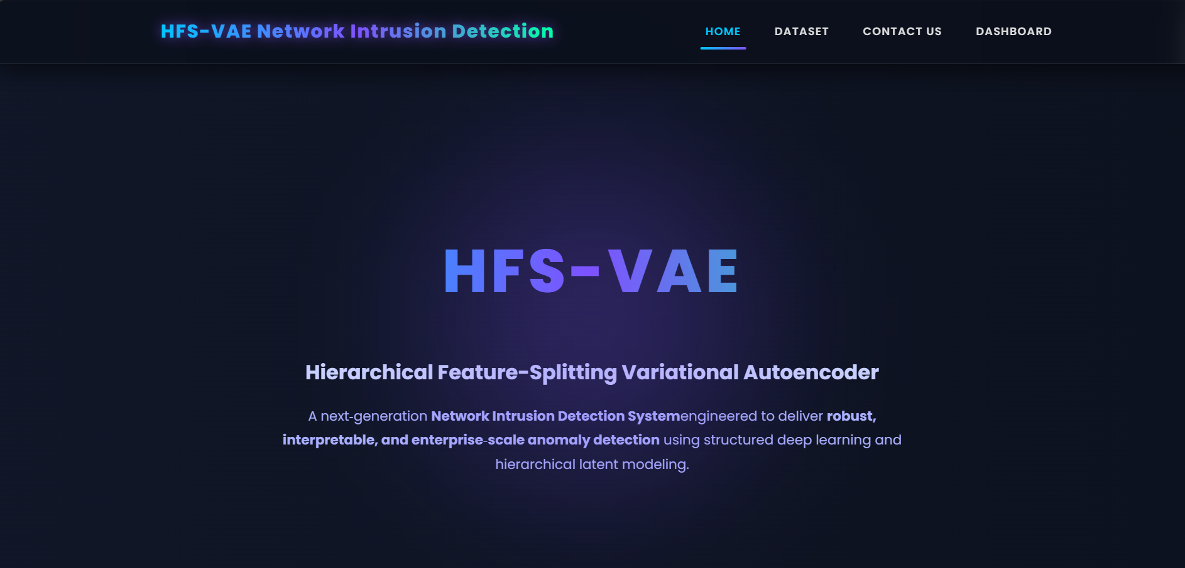
Review No.3
Batch No: BB5
Department of CSE

Slide 20
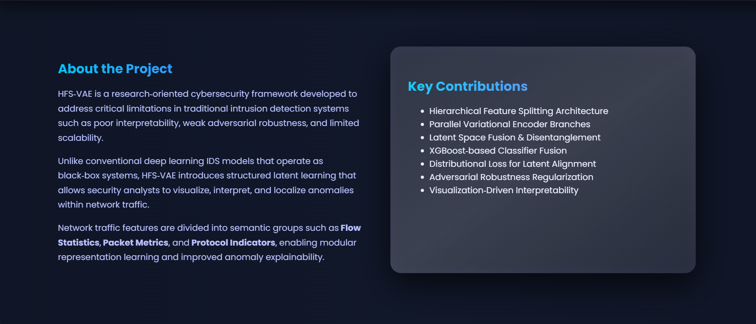
Review No.3
Batch No: BB5
Department of CSE

Slide 21
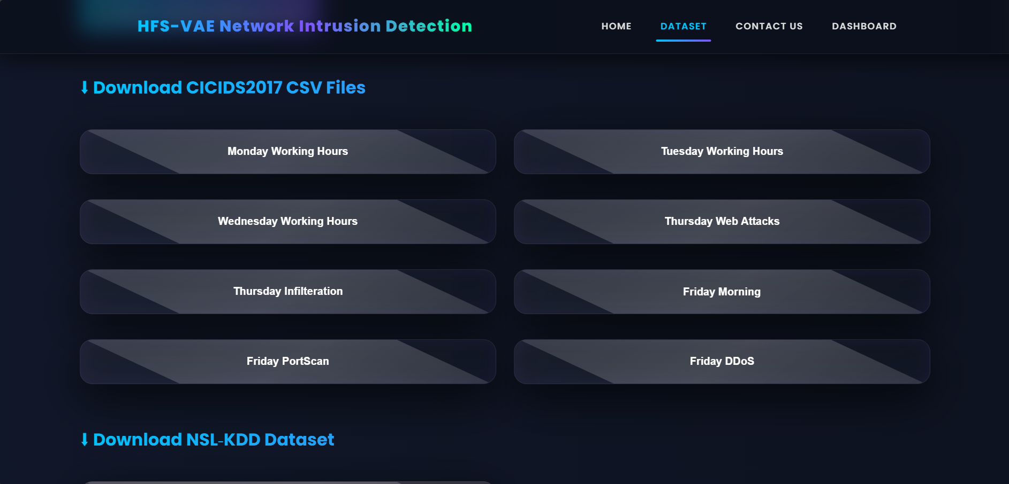
Review No.3
Batch No: BB5
Department of CSE

Slide 22

Review No.3
Batch No: BB5
Department of CSE

Slide 23
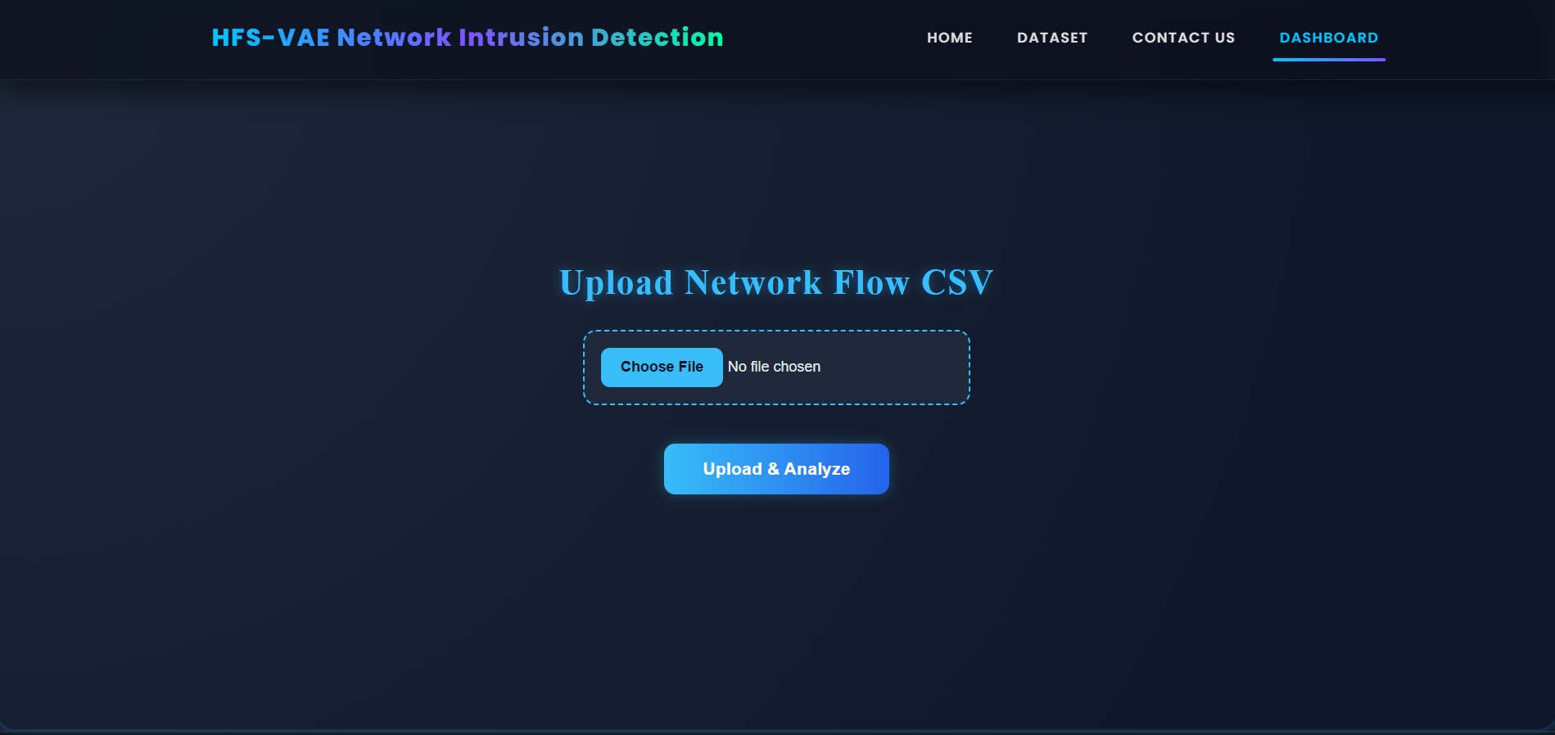
Review No.3
Batch No: BB5
Department of CSE

Slide 24
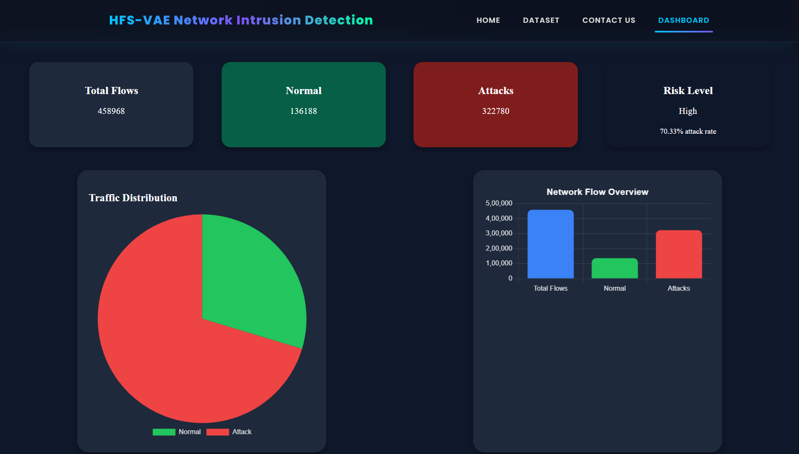
Review No.3
Batch No: BB5
Department of CSE

Slide 25
RESULTS & ANALYSIS
Quantitative Results
Model / Source | DaPtaset | AP | F1 | AUC
HFS-VAE (Ours) | CICIDS2017 | 0.8412 | 0.7463 | 0.88
HFS-VAE (Ours) | NSL-KDD | 0.9234 | 0.7371 | 0.88
The proposed HFS-VAE model was evaluated on CICIDS2017 and NSL-KDD datasets.
It achieved Accuracy – 0.88, Precision – 0.85, Recall – 0.84, and F1-Score – 0.84.
The model outperformed traditional VAE (0.79 F1) and hybrid VAE-XGBoost (0.81 F1) models.
Hierarchical Feature Splitting improved modular learning and interpretability.
XGBoost fusion increased detection accuracy and reduced false alarms.
The results show that HFS-VAE is robust, interpretable, and effective for enterprise-level intrusion detection.
Review No.3
Department of CSE

Slide 26
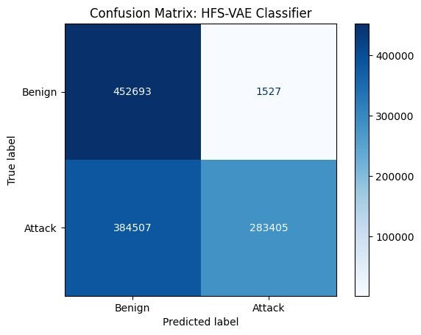
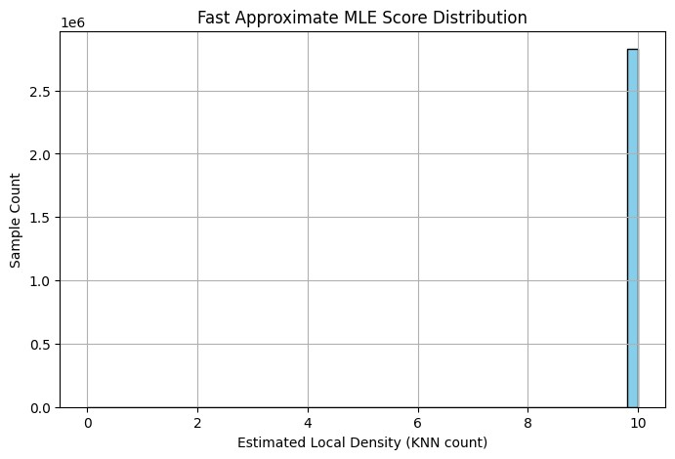
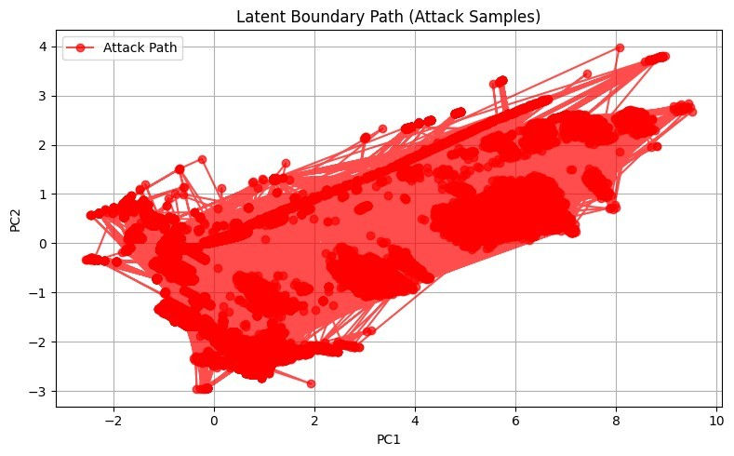
RESULTS & ANALYSIS
Confusion matrix
Latent Boundary Path
Distribution of MLE scores
Review No.3
Department of CSE

Slide 27
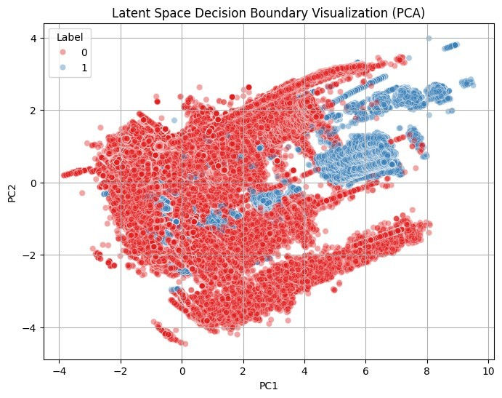
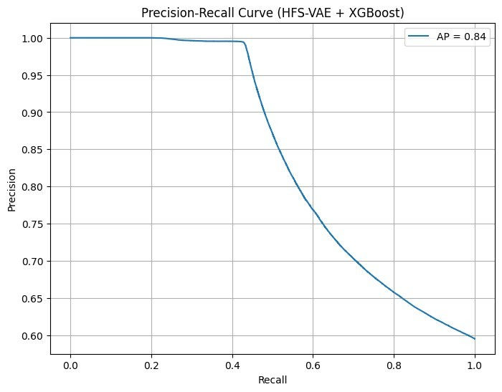
RESULTS & ANALYSIS
Latent Space Visualization
Precision–Recall curve
Review No.3
Department of CSE

Slide 28
CONCLUSION and FUTURE SCOPE
Conclusion
The proposed HFS-VAE model improves interpretability, robustness, and accuracy in intrusion detection.
It uses hierarchical feature splitting with multi-branch VAEs and XGBoost fusion for effective classification.
Achieved F1 ≈ 0.74, AP ≈ 0.84–0.92, and AUC = 0.88, outperforming previous methods like NIDS-Vis.
Future Work
Extend HFS-VAE for real-time intrusion detection.
Apply model compression and pruning for IoT deployment.
Add adversarial training to boost robustness.
Validate on more datasets for better generalization.
Review No.3
Department of CSE

Slide 29
REFERENCES
K. He, D. D. Kim, and M. R. Asghar, “NIDS-Vis: Improving the Generalized Adversarial Robustness of Network Intrusion Detection Systems,” Computers & Security, vol. 145, p. 104028, 2024.
M. Farhan et al., “Network-Based Intrusion Detection Using Deep Learning Technique,” Scientific Reports, vol. 15, p. 25550, 2025.
Y. Xue, C. Kang, and H. Yu, “HAE-HRL: A Network Intrusion Detection System Utilizing a Novel Autoencoder and a Hybrid Enhanced LSTM-CNN Residual Network,” Computers & Security, vol. 151, p. 104328, 2025.
Y. Ren et al., “A Lightweight Unsupervised Intrusion Detection Model Based on Variational Auto-Encoder,” Sensors, vol. 23, p. 8407, 2023.
H. Huang et al., “Self-Organizing Maps-Assisted Variational Autoencoder for Unsupervised Network Anomaly Detection,” Symmetry, vol. 17, p. 520, 2025.
A. Kumar et al., “A Scalable Hybrid Autoencoder–Extreme Learning Machine Framework for Adaptive Intrusion Detection,” Future Internet, vol. 17, p. 221, 2025.
Z. Li, C. Huang, and W. Qiu, “An Intrusion Detection Method Combining Variational Auto-Encoder and Generative Adversarial Networks,” Computer Networks, vol. 253, p. 110724, 2024.
Y. Zhang, R. C. Muniyandi, and F. Qamar, “A Review of Deep Learning Applications in Intrusion Detection Systems,” Applied Sciences, vol. 15, p. 1552, 2025.
Review No.3
Department of CSE

Slide 30
ACKNOWLEGEMENTS
We would like to express our sincere gratitude to the faculty and staff of Narasaraopeta Engineering College for their guidance and encouragement throughout the development of this project. Their insights and expertise have been invaluable.
We also extend our thanks to the administration for providing the necessary resources and a platform to showcase our work. This opportunity has been instrumental in enhancing our learning and growth.
Team No:BB5
Guide: Munnangi Suresh
Roll No’s: 22471A0585
22471A05C9
22471A05D1
Review No.3
Department of CSE

Slide 31

Review No.3
Department of CSE

